Slide 1
Lecture 4: Circuit Partitioning – II
Tsung-Wei (TW) Huang
Department of Electrical and Computer Engineering
University of Utah, Salt Lake City, UT

Slide 2
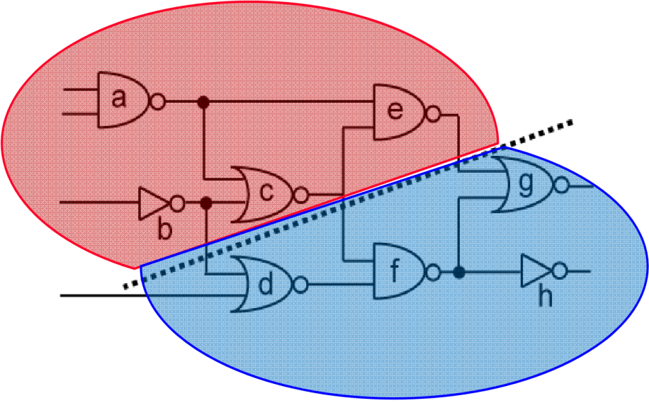
Recap: Circuit Partition
An essential step for reducing algorithm design complexity
Divide and conquer (D&C)
Input
A circuit graph
Output
A set of partitioned subgraphs
Objective
Minimize cross-connection

Slide 3
Recap: KL Algorithm
1. Pair-wise exchange of nodes to reduce cut size
2. Allow cut size to increase temporarily within a pass
3. Compute the gain of a swap
Repeat
Perform a feasible swap of max gain
Mark swapped nodes “locked”
Update swap gains
Until no feasible swap
4. Find max prefix partial sum in gain sequence g₁, g₂, …, g_{m}
5. Make corresponding swaps permanent
6. Start another pass if current pass reduces the cut size
u •
v •
v •
u •
locked

Slide 4
Recap: Drawbacks of KL Algorithm
Handle only unit vertex weights
Vertex weights might represent block sizes, different from blocks to blocks in real situation
Handle only exact bisection
Need dummy vertices to handle the unbalanced problem
Handle only non-hypergraphs
Practical circuits have many terminal nodes for each cell output
Need to handle multi-terminal nets directly
B
A
A has two terminals, B and C!
C
D

Slide 5
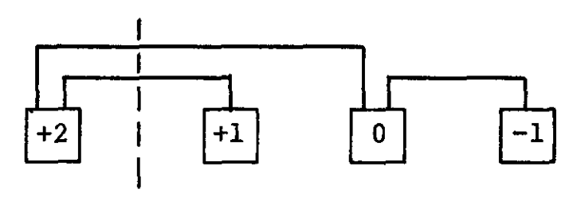
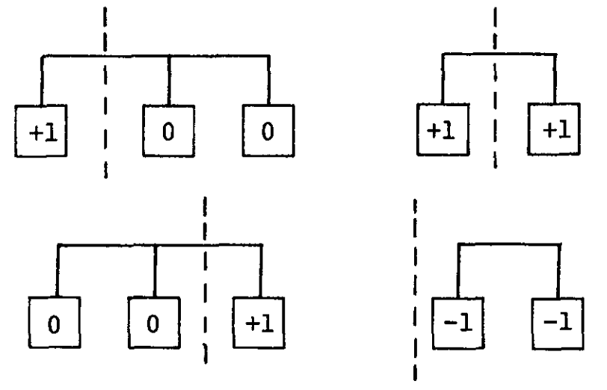
Fiduccia-Mattheyses (FM) Algorithm
Fiduccia and Mattheyses, “A linear time heuristic for improving network partitions,” ACM Design Automation Conference (DAC), 1982
Cell gains based on “net”

Slide 6
Hypergraph Partition Problem Formulation
Input: A hypergraph with
Set vertices V. (|V| = n)
Set of hyperedges E (total # pins in netlist = p)
Area a_{u} for each vertex u in V
Cost c_{e} for each hyperedge in e
An area ratio r
Output: two partitions X & Y such that
Total cost of hyperedges cut is minimized
area(X) / (area(X) + area(Y)) is about r
This problem has been proven to be NP-complete

Slide 7
Ideas of FM Algorithm
Similar to KL:
Work in passes
Lock vertices after moved
Only move those vertices up to the maximum partial sum of gain
Difference from KL:
Not exchanging pairs of vertices
Move only one vertex at each time
Calculate the gain value based on connected nets
The use of gain bucket data structure

Slide 8
FM Partitioning Algorithm
Moves are made based on object gain
Object Gain: The amount of change in cut crossings that will occur if an object is moved from its current partition into the other partition
A pass description
While there is unlocked object
1. Each object is assigned a gain
2. Objects are put into a sorted gain list
3. The object with the highest gain from the larger of the two sides is selected and moved
4. The moved object is "locked"
5. Gains of "touched" objects are recomputed
6. Gain lists are resorted
Repeat the pass until there is no improvement

Slide 9
FM Algorithm Walkthrough – 1
Let’s focus on 2-pin net first for simplicity
(degenerate to KL)
-1
0
2
0
-1
0
-2
0
0
-2
-1
1
-1
1

Slide 10
FM Algorithm Walkthrough – 2
-1
0
2
0
-1
0
-2
0
0
-2
-1
1
-1
1

Slide 11
FM Algorithm Walkthrough – 3
-1
-2
-2
-2
0
-1
-2
0
0
-2
-1
1
-1
1

Slide 12
FM Algorithm Walkthrough – 4
-1
-2
-2
-2
0
-1
-2
0
0
-2
-1
1
1
-1

Slide 13
FM Algorithm Walkthrough – 5
-1
-2
-2
-2
0
-1
-2
0
0
-2
-1
1
1
-1

Slide 14
FM Algorithm Walkthrough – 6
-1
-2
-2
-2
0
-1
-2
0
-2
-2
1
-1
-1
-1

Slide 15
FM Algorithm Walkthrough – 7
-1
-2
-2
-2
0
-1
-2
0
-2
-2
1
-1
-1
-1

Slide 16
FM Algorithm Walkthrough – 8
-1
-2
-2
-2
-1
-2
0
0
-2
-2
1
-1
-1
-1

Slide 17
FM Algorithm Walkthrough – 9
-1
-2
-2
-2
1
-2
0
-2
-2
-2
1
-1
-1
-1

Slide 18
FM Algorithm Walkthrough – 10
-1
-2
-2
-2
1
-2
0
-2
-2
1
-2
-1
-1
-1

Slide 19
FM Algorithm Walkthrough – 11
-1
-2
-2
-2
1
-2
0
-2
-2
1
-2
-1
-1
-1

Slide 20
FM Algorithm Walkthrough – 12
-1
-2
-2
-2
1
-2
0
-2
-1
-2
-2
-3
-1
-1

Slide 21
FM Algorithm Walkthrough – 13
-1
-2
-2
-2
1
-2
0
-2
-1
-2
-2
-3
-1
-1

Slide 22
FM Algorithm Walkthrough – 14
-1
-2
-2
1
-2
-2
0
-2
-1
-2
-2
-3
-1
-1

Slide 23
FM Algorithm Walkthrough – 15
-1
-2
-2
-1
-2
-2
-2
-2
-1
-2
-2
-3
-1
-1

Slide 24
Implementation Details
Gain Δg(c) for cell c
Δg(c) = FS(c) – TE(c) ,
where the “moving force“ FS(c) is the number of nets connected to c but not connected to any other cells within c’s partition, i.e., cut nets that connect only to c, and
the “retention force“ TE(c) is the number of uncut nets connected to c.
The higher the gain Δg(c), the higher is the priority to move the cell c to the other partition.
Netlist: a {1, 2}, b {1, 2, 3}, c {1, 4}, d {1, 5}, e {3, 4}
3
2
b
e
a
4
c
1
d
5

Slide 25
Implementation Details (cont’d)
Gain Δg(c) for cell c
Δg(c) = FS(c) – TE(c) ,
where the “moving force“ FS(c) is the number of nets connected to c but not connected to any other cells within c’s partition, i.e., cut nets that connect only to c, and
the “retention force“ TE(c) is the number of uncut nets connected to c.
Netlist: a {1, 2}, b {1, 2, 3}, c {1, 4}, d {1, 5}, e {3, 4}
2
3
b
e
a
4
c
1
d
5
2
3
Cell 1: FS(1) = 2 TE(1) = 1 Δg(1) = 1
Cell 2: FS(2) = 0 TE(2) = 1 Δg(2) = -1
Cell 3: FS(3) = 1 TE(3) = 1 Δg(3) = 0
Cell 4: FS(4) = 1 TE(4) = 1 Δg(4) = 0
Cell 5: FS(5) = 1 TE(5) = 0 Δg(5) = 1
b
e
a
4
c
1
d
5

Slide 26
Maximum Positive Gain
Find the maximum positive gain G_{m} for each pass
The maximum positive gain G_{m} is the cumulative cell gain of m moves that produce a minimum cut cost.
G_{m} is determined by the maximum sum of cell gains Δg over a prefix of m moves in a pass

Slide 27
Area Ratio Factor
The ratio factor is the relative balance between the two partitions with respect to cell area It is used to prevent all cells from clustering into one partition.
The ratio factor r is defined as
where area(A) and area(B) are the total respective areas of partition A and partition B

Slide 28
Balanced Partition
The balance criterion enforces the ratio factor
To ensure feasibility, the maximum cell area area_{max}(V) must be taken into account
A partitioning of V into two partitions A and B is said to be balanced if
[ r ∙ area(V) – area_{max}(V) ] ≤ area(A) ≤ [ r ∙ area(V) + area_{max}(V) ]

Slide 29
Base Cell
A base cell is a cell c that has the greatest cell gain Δg(c) among all free cells, and whose move does not violate the balance criterion
Base cell
Cell 1: FS(1) = 2 TE(1) = 1 Δg(1) = 1
Cell 2: FS(2) = 0 TE(2) = 1 Δg(2) = -1
Cell 3: FS(3) = 1 TE(3) = 1 Δg(3) = 0
Cell 4: FS(4) = 1 TE(4) = 1 Δg(4) = 0

Slide 30
FM Algorithm (One Pass)
A
2
3
B
Given: Ratio factor r = 0.375
area(Cell_1) = 2 area(Cell_2) = 4 area(Cell_3) = 1 area(Cell_4) = 4 area(Cell_5) = 5
b
e
a
4
c
d
1
5
Step 0: Compute the balance criterion
[ r ∙ area(V) – area_{max}(V) ] ≤ area(A) ≤ [ r ∙ area(V) + area_{max}(V) ]
0.375 * 16 – 5 = 1 ≤ area(A) ≤ 11 = 0.375 * 16 +5.

Slide 31
FM Algorithm (One Pass)
FS(c): # cut nets that connect only to c TE(c): # uncut nets connected to c
A
2
3
B
b
e
a
4
c
d
1
5
Step 1: Compute the gains of each cell Cell 1: FS(Cell_1) = 2 TE(Cell_1) = 1 Δg(Cell_1) = 1
Cell 2: FS(Cell_2) = 0 TE(Cell_2) = 1 Δg(Cell_2) = -1
Cell 3: FS(Cell_3) = 1 TE(Cell_3) = 1 Δg(Cell_3) = 0
Cell 4: FS(Cell_4) = 1 TE(Cell_4) = 1 Δg(Cell_4) = 0
Cell 5: FS(Cell_5) = 1 TE(Cell_5) = 0 Δg(Cell_5) = 1

Slide 32
FM Algorithm (One Pass)
Cell 1: FS(Cell_1) = 2 TE(Cell_1) = 1 Δg(Cell_1) = 1
Cell 2: FS(Cell_2) = 0 TE(Cell_2) = 1 Δg(Cell_2) = -1
Cell 3: FS(Cell_3) = 1 TE(Cell_3) = 1 Δg(Cell_3) = 0
Cell 4: FS(Cell_4) = 1 TE(Cell_4) = 1 Δg(Cell_4) = 0
Cell 5: FS(Cell_5) = 1 TE(Cell_5) = 0 Δg(Cell_5) = 1
A
2
3
B
b
e
a
4
c
d
1
5
Ratio factor r = 0.375
area(Cell_1) = 2 area(Cell_2) = 4 area(Cell_3) = 1 area(Cell_4) = 4 area(Cell_5) = 5
Step 2: Select the base cell
Possible base cells are Cell 1 and Cell 5
Balance criterion after moving Cell 1: area(A) = area(Cell_2) = 4
Balance criterion after moving Cell 5: area(A) = area(Cell_1) + area(Cell_2) + area(Cell_5) = 11
Both moves respect the balance criterion. Let’s select Cell 1 (can also do Cell 5).

Slide 33
FM Algorithm (One Pass)
FS(c): # cut nets that connect only to c TE(c): # uncut nets connected to c
A
2
3
B
b
e
a
4
c
d
1
5
Step 3: Fix base cell, update Δg values
Cell 2: FS(Cell_2) = 2 TE(Cell_2) = 0 Δg(Cell_2) = 2
Cell 3: FS(Cell_3) = 0 TE(Cell_3) = 1 Δg(Cell_3) = -1
Cell 4: FS(Cell_4) = 0 TE(Cell_4) = 2 Δg(Cell_4) = -2
Cell 5: FS(Cell_5) = 0 TE(Cell_5) = 1 Δg(Cell_5) = -1
After Iteration i = 1: Partition A₁ = {2}, Partition B₁ = {1,3,4,5}, with fixed cell {1}.

Slide 34
FM Algorithm (One Pass)
A
2
3
B
Lock Cell 1
b
e
Cell 2: FS(Cell_2) = 2 TE(Cell_2) = 0 Δg(Cell_2) = 2
Cell 3: FS(Cell_3) = 0 TE(Cell_3) = 1 Δg(Cell_3) = -1
Cell 4: FS(Cell_4) = 0 TE(Cell_4) = 2 Δg(Cell_4) = -2
Cell 5: FS(Cell_5) = 0 TE(Cell_5) = 1 Δg(Cell_5) = -1
a
4
c
d
1
5
Next iteration …
Cell 2 has maximum gain Δg₂ = 2, area(A) = 0, balance criterion is violated
Cell 3 has next maximum gain Δg₂ = -1, area(A) = 5, balance criterion is met
Cell 5 has next maximum gain Δg₂= -1, area(A) = 9, balance criterion is met
Move cell 3, updated partitions: A₂ = {2,3}, B₂ = {1,4,5}, with fixed cells {1,3}

Slide 35
FM Algorithm (One Pass)
A
2
3
Lock Cell 1 and Cell 3
e
Cell 2: Δg(Cell_2) = 1
Cell 4: Δg(Cell_4) = 0
Cell 5: Δg(Cell_5) = -1
a
b
B
4
c
d
1
5
Next iteration …
Cell 2 has maximum gain Δg₃ = 1, area(A) = 1, balance criterion is met. Move cell 2, updated partitions: A₃ = {3}, B₃ = {1,2,4,5}, with fixed cells {1,2,3}

Slide 36
FM Algorithm (One Pass)
B
2
3
A
Lock Cell 1, Cell 3, and Cell 2
e
a
b
4
Cell 4: Δg(Cell_4) = 0
Cell 5: Δg(Cell_5) = -1
c
d
1
5
Next iteration …
Cell 4 has maximum gain Δg₄ = 0, area(A) = 5, balance criterion is met. Move cell 4, updated partitions: A₄ = {3,4}, B₃ = {1,2,5}, with fixed cells {1,2,3,4}

Slide 37
FM Algorithm (One Pass)
B
2
3
A
Lock Cell 1, Cell 3, Cell 2, and Cell 4
e
a
b
4
Cell 5: Δg(Cell_5) = -1
c
d
1
5
Next iteration …
Cell 5 has maximum gain Δg₅ = -1, area(A) = 10, balance criterion is met. Move cell 5, updated partitions: A₄ = {3,4,5}, B₃ = {1,2}, all cells {1,2,3,4,5} fixed.

Slide 38
FM Algorithm (One Pass)
Ratio factor r = 0.375
area(Cell_1) = 2 area(Cell_2) = 4 area(Cell_3) = 1 area(Cell_4) = 4 area(Cell_5) = 5
B
2
3
A
End of each pass: find best move sequence c₁ … c_{m}
G₁ = Δg₁ = 1 G₂ = Δg₁ + Δg₂ = 0 G₃ = Δg₁ + Δg₂ + Δg₃ = 1 G₄ = Δg₁ + Δg₂ + Δg₃ + Δg₄ = 1 G₅ = Δg₁ + Δg₂ + Δg₃ + Δg₄ + Δg₅ = 0.
e
a
b
4
c
d
1
5
found in iterations 1, 3 and 4.
The move prefix m = 4 is selected due to the better balance ratio (area(A) = 5); the four cells 1, 2, 3 and 4 are then moved.
Result of Pass 1: Current partitions: A = {3,4}, B = {1,2,5}, cut cost reduced from 3 to 2.
Maximum positive cumulative gain

Slide 39
Gain-based Bucket Data Structure
+pmax
Max
Gain
Cell
#
Cell
#
-pmax
1
2
n

Slide 40
Incremental Update
Which gain values need update after moving Cell 3?
A
2
3
B
A
2
3
b
e
e
a
a
b
B
4
4
c
c
d
d
1
5
1
5

Slide 41
Time Complexity of FM Algorithm
For each pass
Constant time to find the best vertex to move
After each move, time to update gain buckets is proportional to degree of vertex moved
Total time is O(p), where p is total number of pins
Number of passes is usually small
Gain values converge very quickly

Slide 42
Programming Assignment #1
Implement FM partitioning algorithm
https://github.com/tsung-wei-huang/ece5960-physical-design/tree/main/PA1
Two checkpoint dues, 9/7 and 9/14 23:59 PM
https://github.com/tsung-wei-huang/ece5960-physical-design/issues/2
Final Due on 9/21 (Wed) 23:59 PM
Upload your solutions to twhuang-server-01.ece.utah.edu
Account: ece6960-fall22
Place your source code + README under PA1/your_uid/
README should contain instruction to compile & run your code

Slide 43
Programming Assignment #1 (cont’d)
In addition to source code + README, upload a report with:
A table showing your results of each benchmark
A section discussing what challenges you encounter
A section discussing how you overcome those challenges
Also discuss unsolved challenges
The report needs to be just a one- or two-page pdf
No need to be lengthy …
Upload your report to the class GitHub page
https://github.com/tsung-wei-huang/ece5960-physical-design/issues/1
Due 9/21 23:59 PM

Slide 44
In-class Presentation: 9/14
Circuit partition research presentation on 9/14 (in class)
George Karypis and Vipin Kumar, "Multilevel k-way Hypergraph Partitioning," 1999 ACM/IEEE Design Automation Conference (DAC)
Honghua Yang and Martin Wong, "Efficient Network Flow Based Min-Cut Balanced Partitioning," 1994 ACM/IEEE International Conference on Computer-aided Design (ICCAD)
Masahiro Tanaka, Kenjiro Taura, Toshihiro Hanawa, Kentaro Torisawa, "Automatic Graph Partitioning for Very Large-scale Deep Learning," 2021 IEEE International Parallel and Distributed Processing Symposium (IPDPS 2021)
https://github.com/tsung-wei-huang/ece5960-physical-design/issues/9

Slide 45
Summary
We have discussed FM partitioning algorithm
Inherited greedy movement ideas from KL algorithm
Extended to hypergraph
Incorporated area constraint (balanced partition)
We have discussed implementation details of FM algorithm
Bucket list data structure to keep track of gains and cells
Incremental update for gain values

